Slide 1

Employment Security Council Meeting
October 6th, 2025

Slide 2


Slide 3
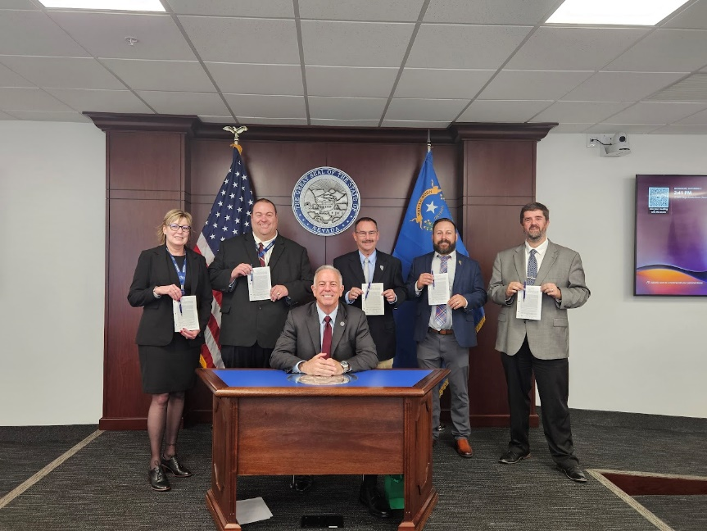
Taking a moment…
In prior years, we’ve presented the “state solvency measure.” The COVID recession exposed significant weaknesses in this formula, and it was no longer providing valuable guidance. AB 21 of the 2025 legislative session eliminated this formula, so moving forward we’re relying on the Average High Cost Multiple (as we have
presented in the past) instead.

Slide 4

Presentation Overview
Economic Conditions and Context
Unemployment Insurance Trends
UI Trust Fund Projections and Solvency
Where are we going?

Slide 5
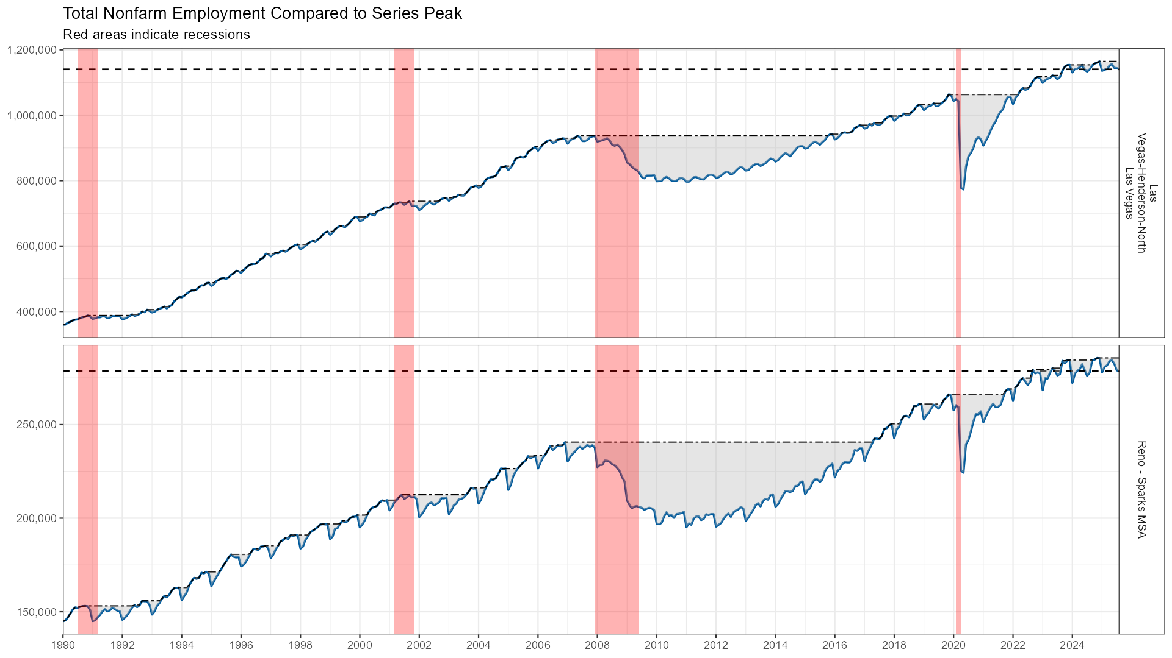
Current Employment Trends

Slide 6
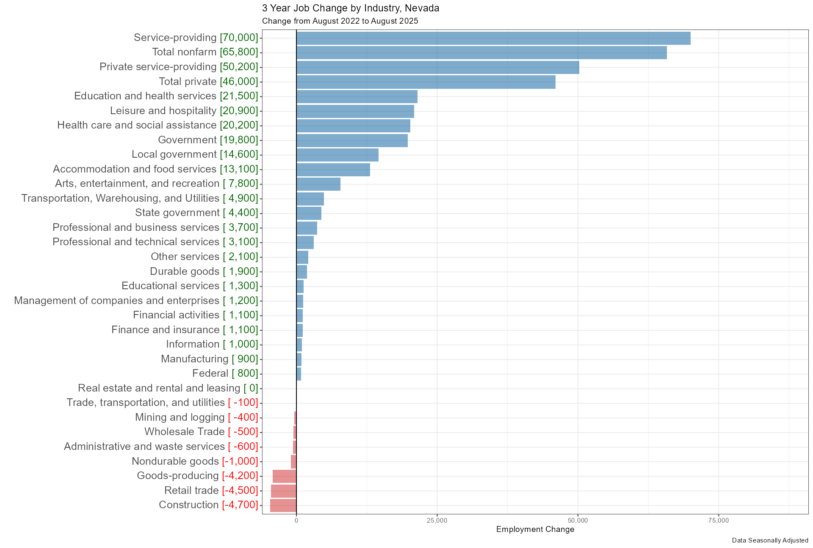
Most Industries Added Jobs 2022-2025

Slide 7
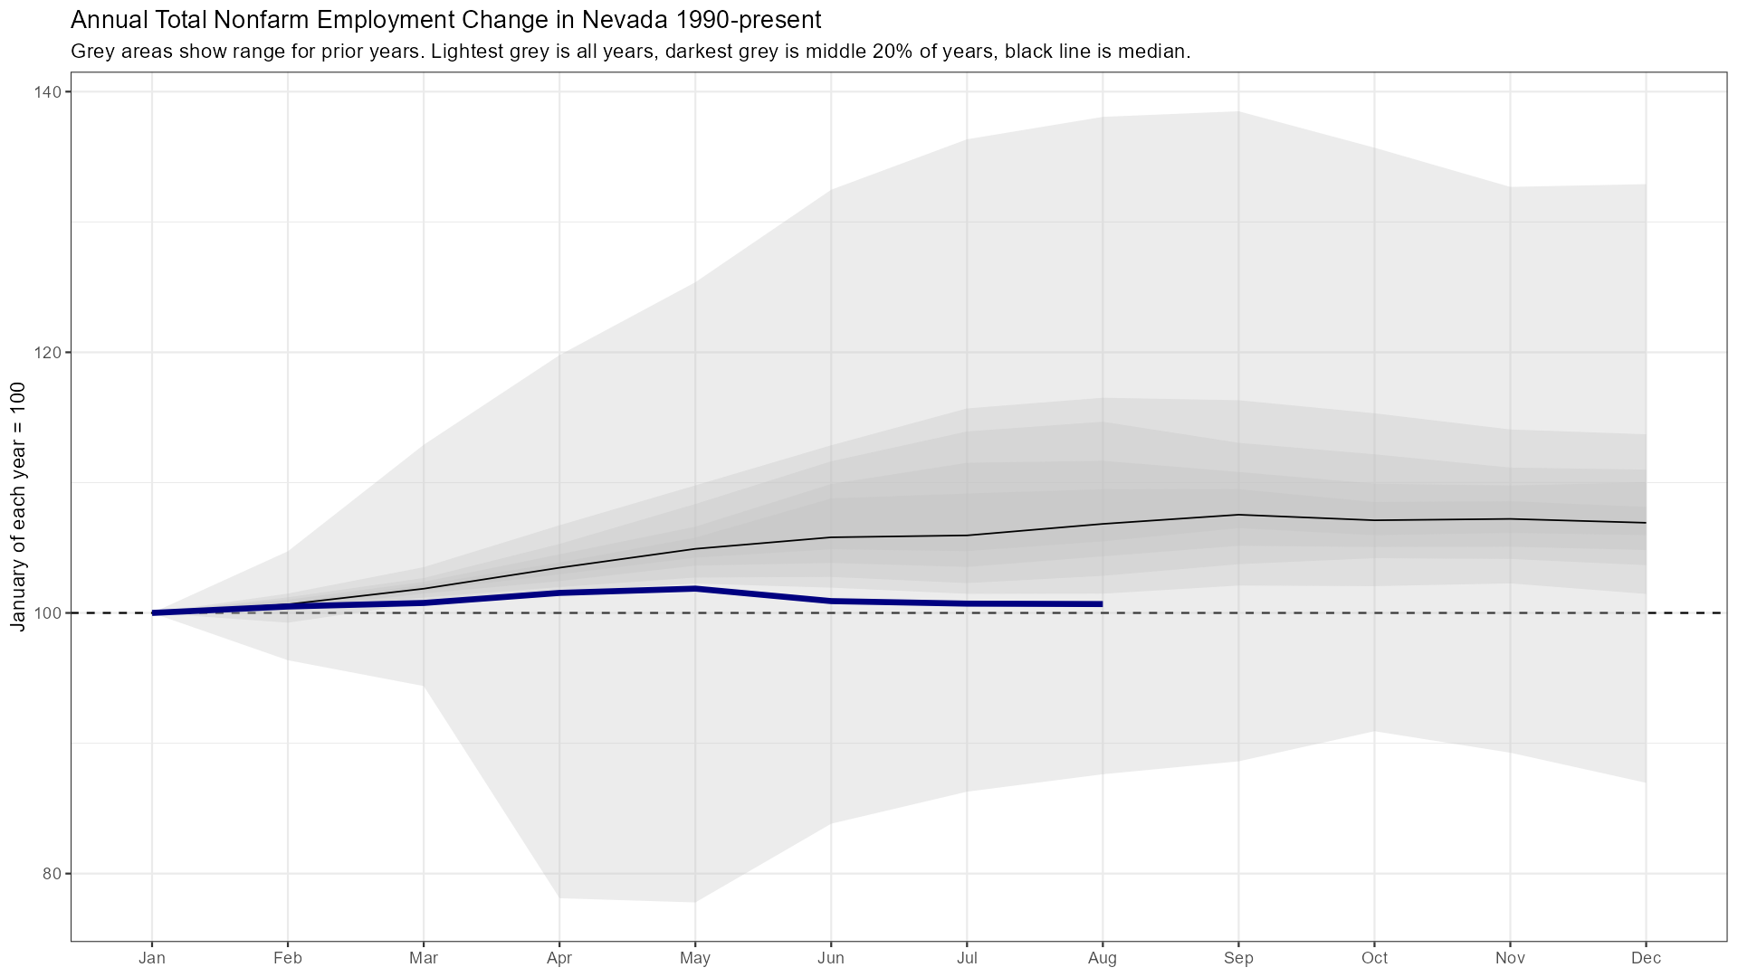
Recent Job Trends Historically Flat

Slide 8
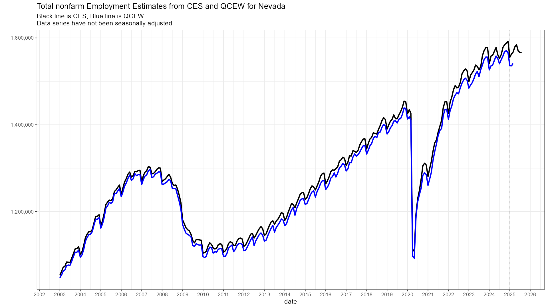
Annual Revisions Likely Negative

Slide 9
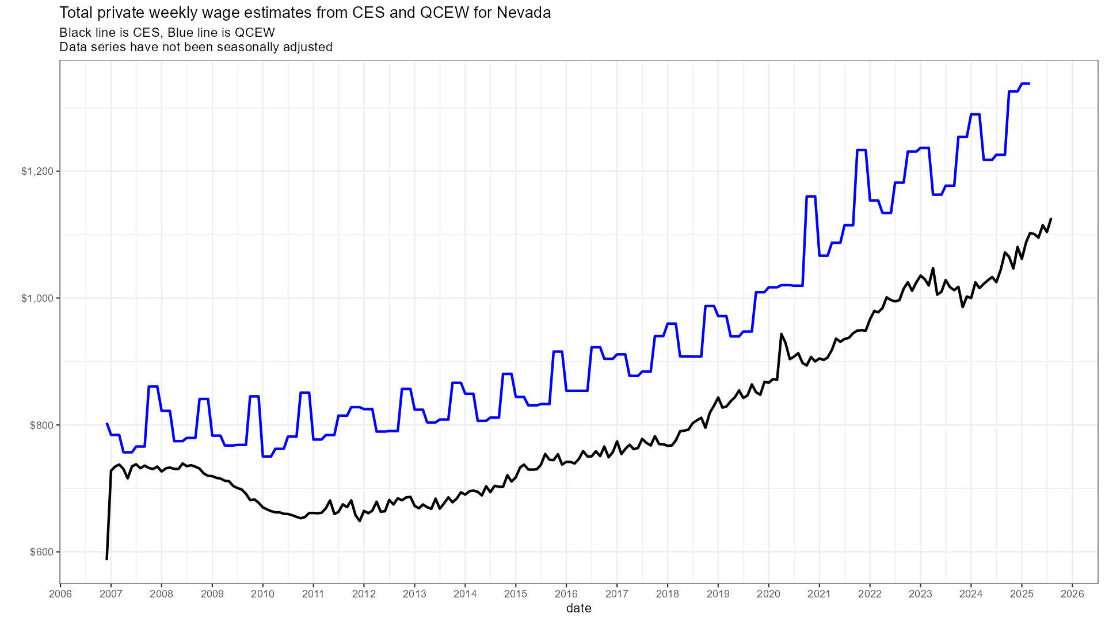
Wage Growth is Holding Up

Slide 10
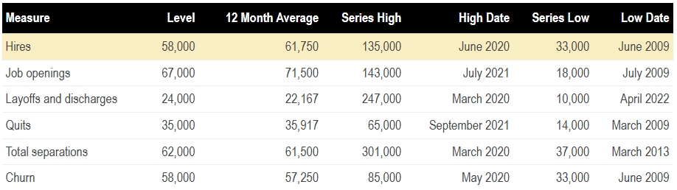
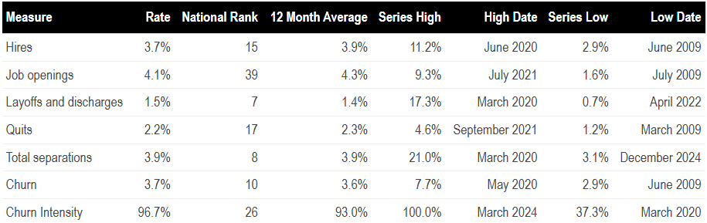
Job Turnover is Slowing

Slide 11
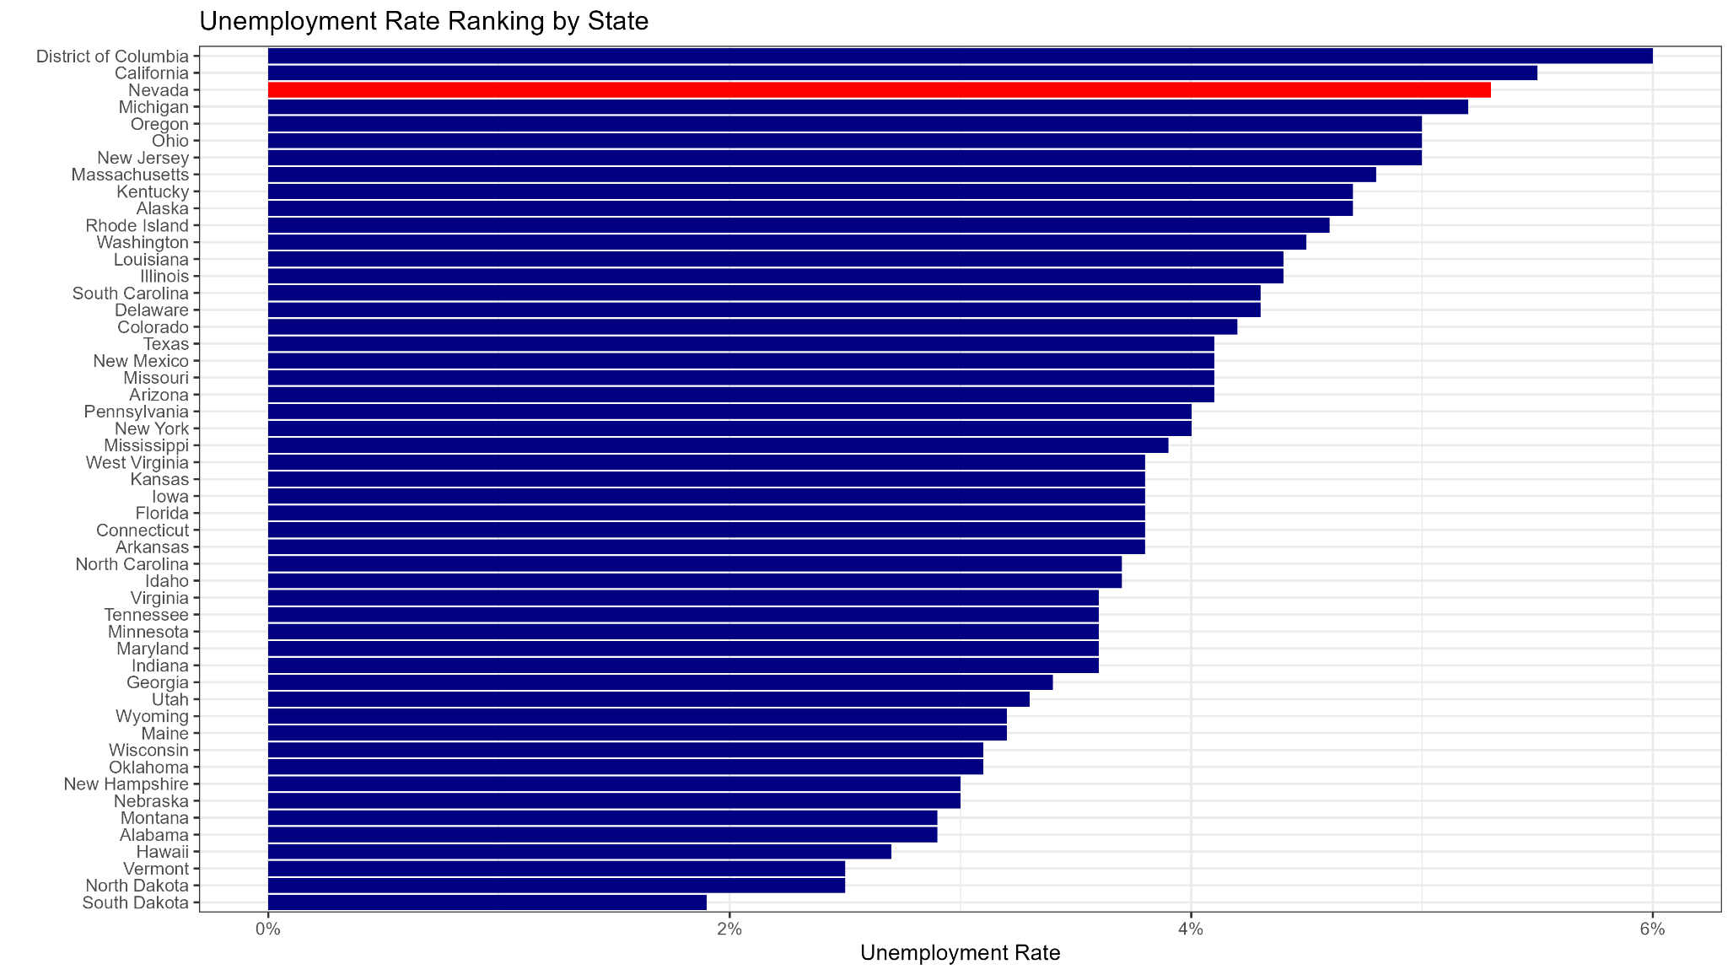
Unemployment Higher than Most States

Slide 12
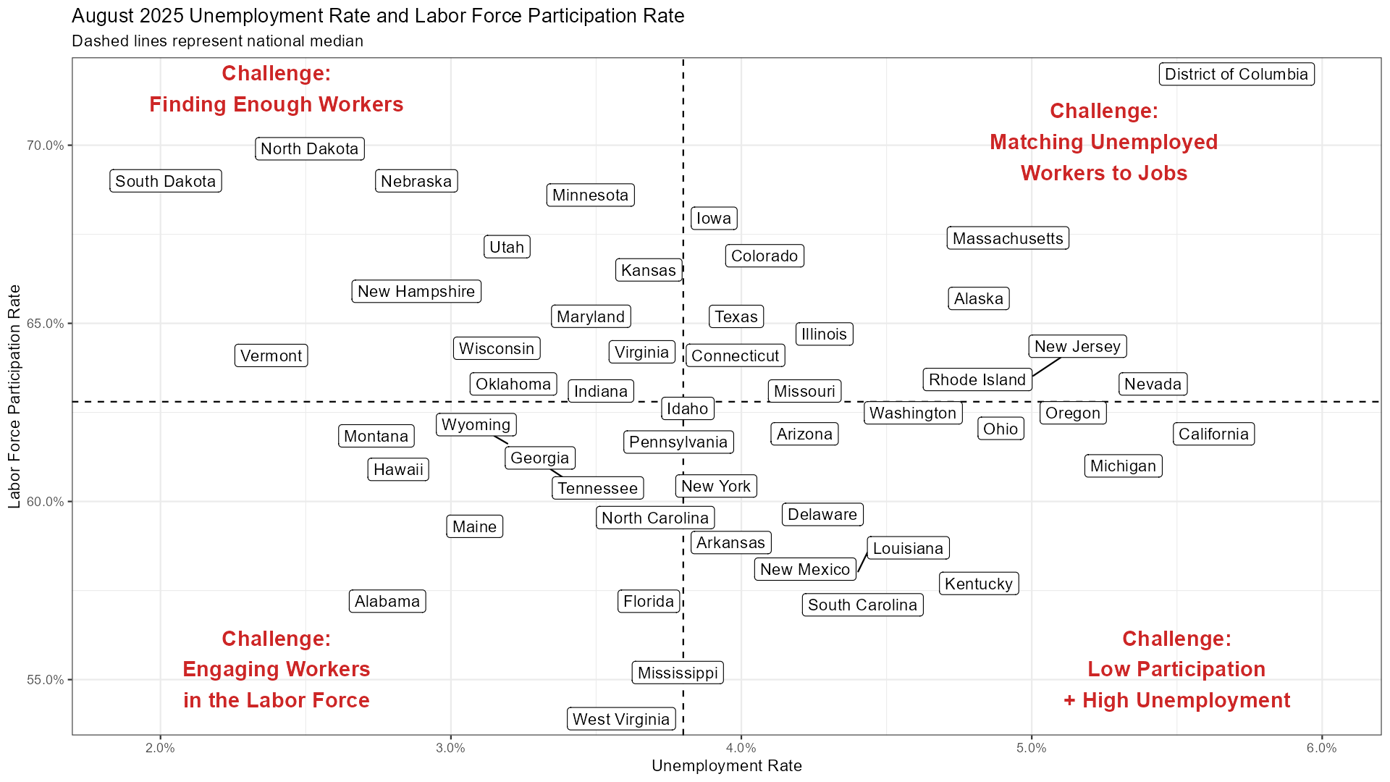
But Participation is Above-Average

Slide 13
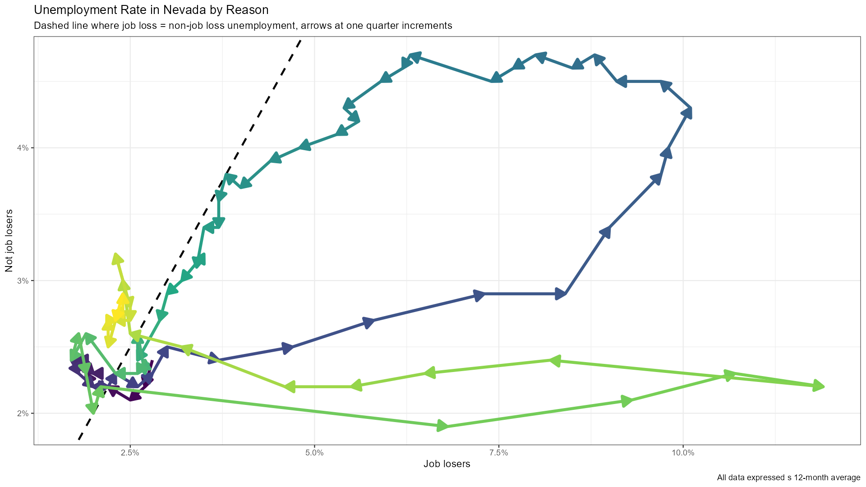
Reason for Unemployment Still Positive
Current level of unemployment not driven by job loss
Great Recession
COVID Recession

Slide 14
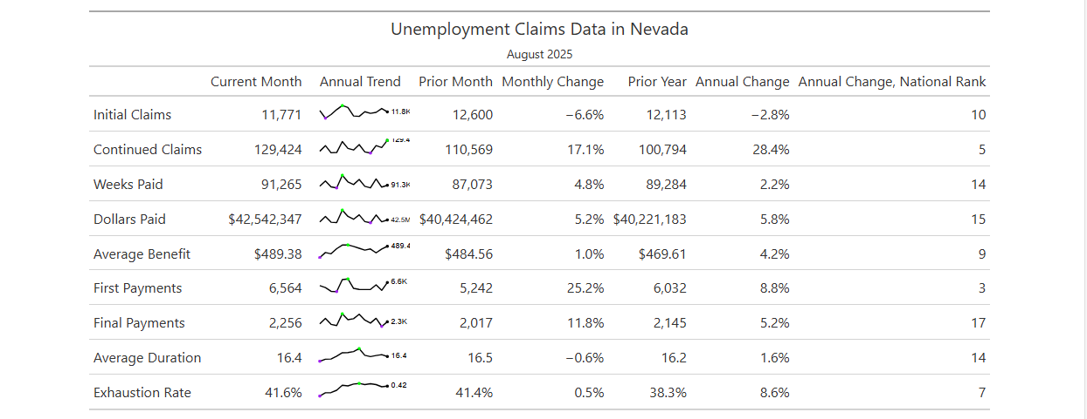
UI Duration and Exhaustions Rising

Slide 15
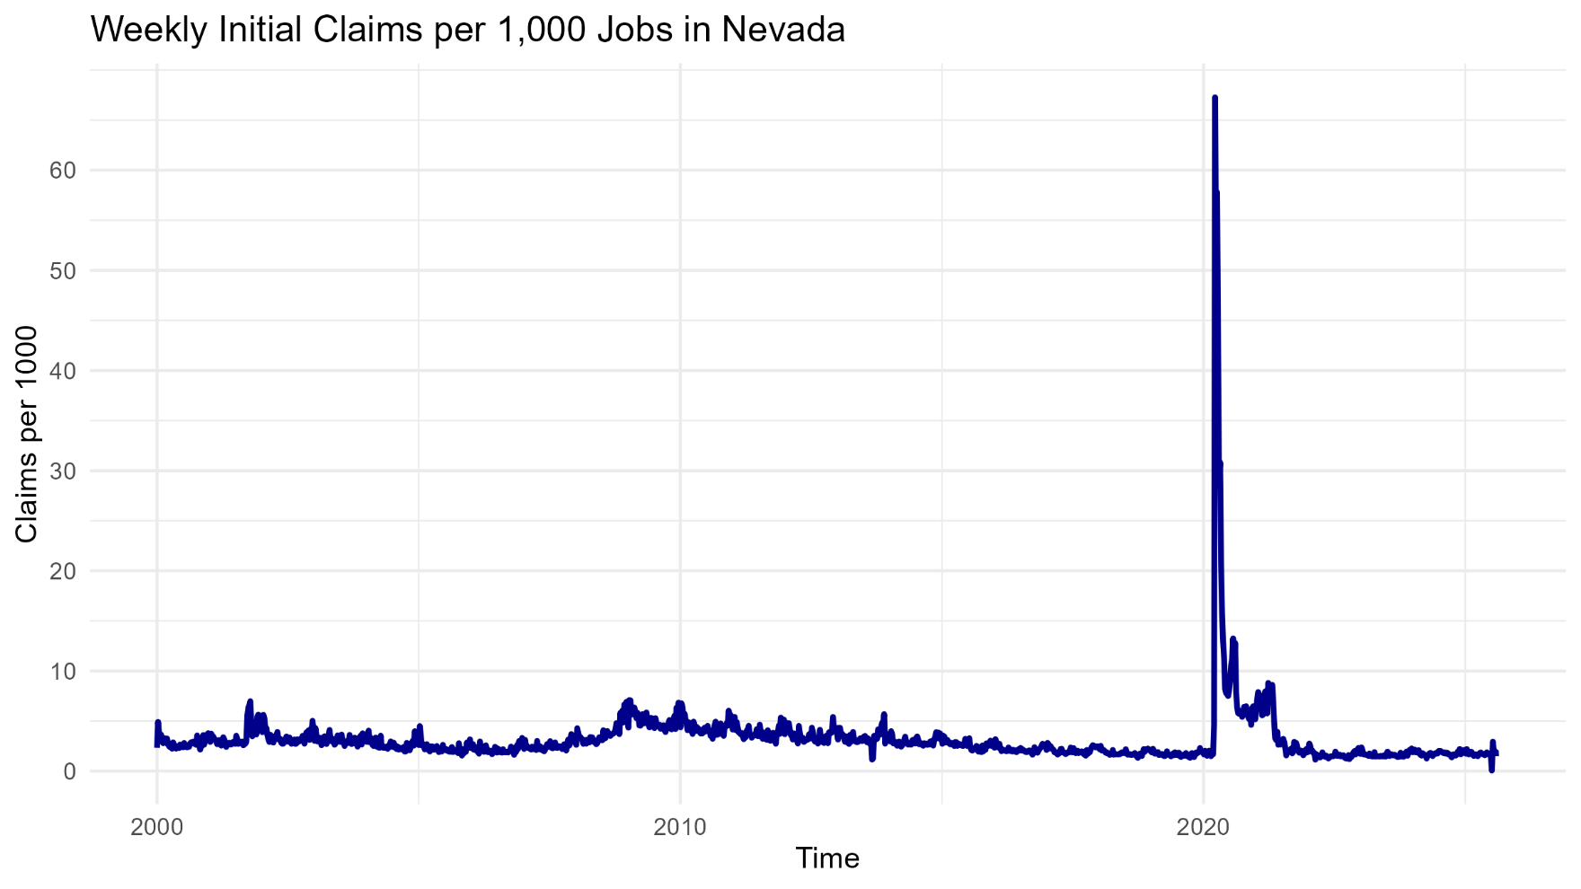
Trend in New UI Claims

Slide 16
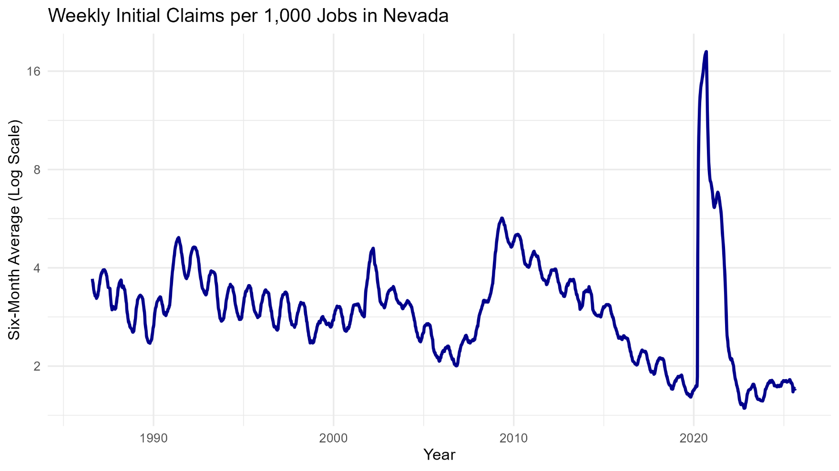
Trend in New UI Claims

Slide 17
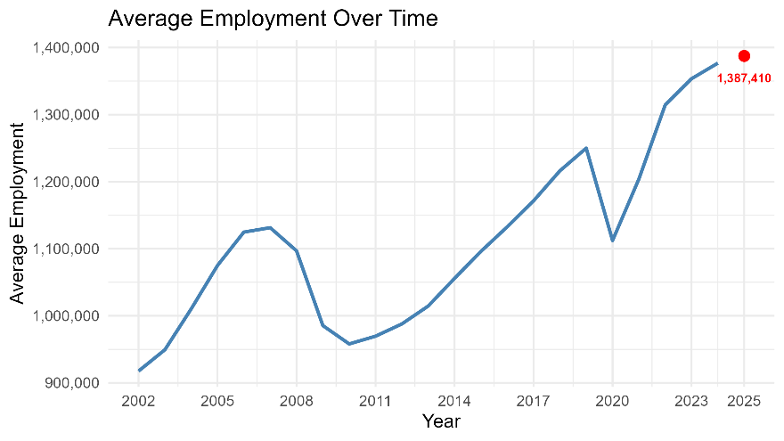
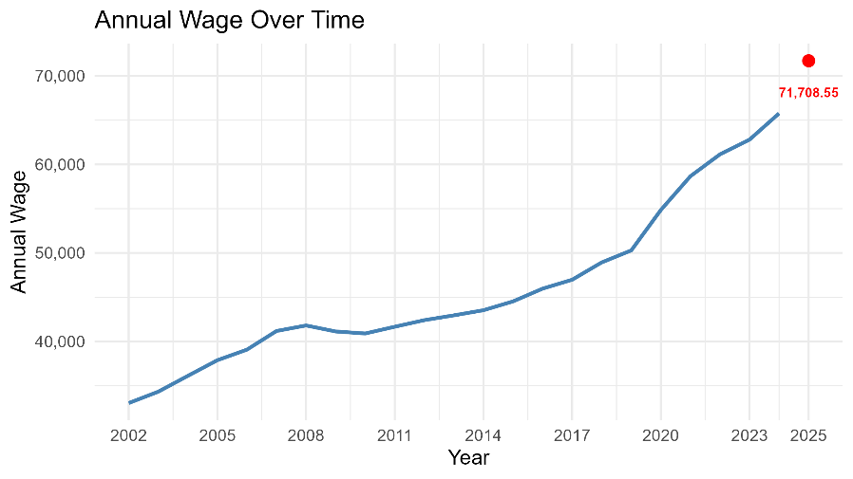
Taxable Wage Base
Modest Employment Growth and Robust Wage Growth
* Used Annual QCEW Data
Average Employment
1,376,705 (2024) to 1,387,410(2026)
Annual Wage (Total wages/ Average Employment
$65,771(2024) to $71,709 (2026)
Average ratio of taxable wages to total wages
55.52%
Forecasted value of average employment * fore-casted value of annual wage * average ratio of taxable wages to total wages =
$54,946,690,671

Slide 18
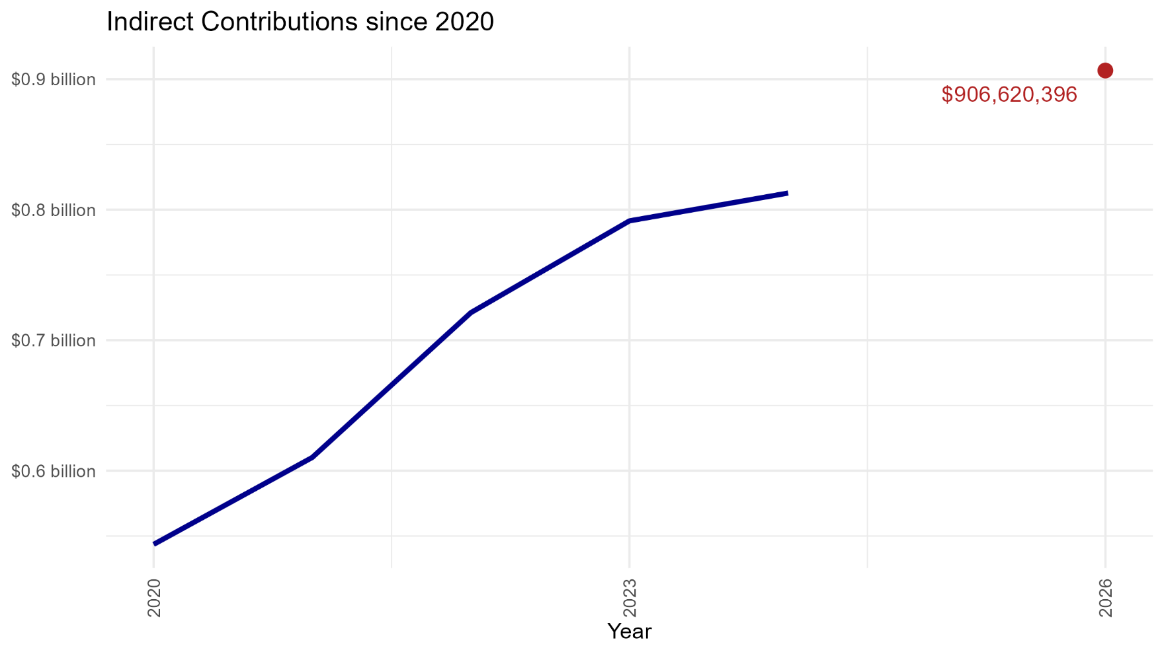
Projected Contributions (1.65% Rate)

Slide 19
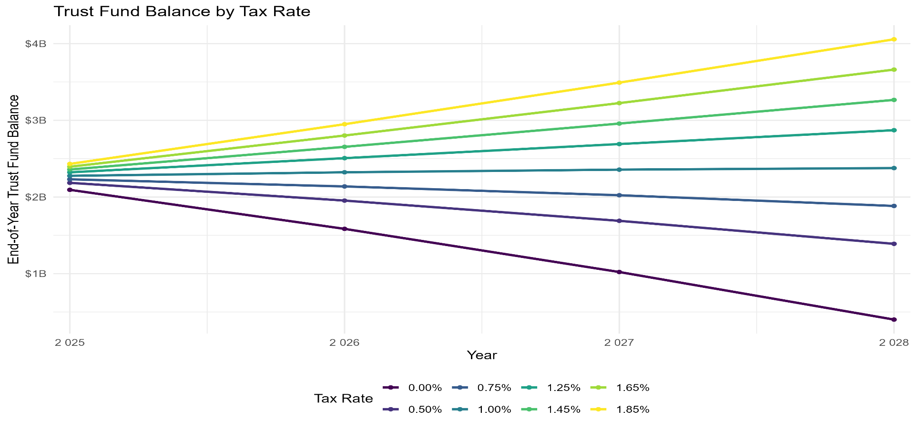
Trust Fund Impacts
Beginning Trust Fund Balance
$2,256,676,817 as of September 19, 2025
Notes:
This shows the projected balance of the trust fund given certain tax rates. The contributions values follow the same predictive model used before (change in annual wage * change in average employment * average ratio of taxwage/totalwage) for the taxable wage base. From there, we multiply it by one of the rates displayed. Benefits is calculated by last benefits value (August 1, 2025) * change in average employment * change in average weekly wage. Then use a compound growth rate. The trust fund goes up or down based on the net of these two.

Slide 20
Historic Cash Flows
 |  | Actual | Actual | Actual | Actual | Actual | Actual | Preliminary
 |  | 2019 | 2020 | 2021 | 2022 | 2023 | 2024 | 2025
UI Trust Fund Level: October - September
Beginning Fund Balance (Millions) |  | 1,416.30 | 1,864.60 | 291 | -76 | 795.5 | 1,412.9 | 1,742.9
Contributions |  | 674 | 617.9 | 595.6 | 752.7 | 828 | 848.3 | 920.3
Benefit Payments |  | 268.7 | 2,232.20 | 862.3 | 228 | 349.2 | 497.7 | 529.2
Other Items |  | 43.1 | 40.7 | -100.3 | 346.7 | 146.6 | 20.6 | 73.1
Net Change in Fund |  | 448.3 | -1,573.60 | -367 | 871.4 | 617.4 | 330.0 | 464.2
Ending Fund Balance (Millions) |  | 1,864.6 | 291 | -76 | 795.5 | 1,412.9 | 1,742.9 | 2,207.1
AHCM Solvency Level (Millions) |  | 657.3 | -987.2 | -1,861.6 | -1,297.9 | -1,110.1 | -856.5 | -475.7
AHCM Target (Millions) |  | 1,207.3 | 1,278.2 | 1,785.6 | 2,093.4 | 2,523.0 | 2,599.4 | 2,682.9
All-Time High Cost Multiple |  | 1.56 | 0.11 | -0.02 | 0.14 | 0.23 | 0.46 | 0.59
Average High Cost Multiple |  | 1.54 | 0.23 | -0.04 | 0.38 | 0.56 | 0.67 | 0.82
Average Tax Rate |  | 1.85% | 1.65% | 1.65% | 1.65% | 1.65% | 1.65% | 1.65%
CEP Assessment |  | 0.05% | 0.05% | 0.05% | 0.05% | 0.05% | 0.05% | 0.05%
Total Cost to Employers |  | 1.90% | 1.70% | 1.70% | 1.70% | 1.70% | 1.70% | 1.70%
Average Cost per Employee at Max Taxable Wage (excl FUTA & Interest) |  | $592.80 | $552.50 | $567.80 | $622.20 | $681.70 | $690.20 | $710.60
Taxable Wage Base |  | $31,200 | $32,500 | $33,400 | $36,600 | $40,100 | $40,600 | $41,800
Without COVID, we’d be at an AHCM of 1.18, or around $350 million above solvency level.

Slide 21
Projected Cash Flows
 |  | 1.45% Forecast | 1.65% Forecast | 1.0 AHCM Forecast
 |  | 2026 | 2026 | 2026
UI Trust Fund Level: October - September
Beginning Fund Balance (Millions) |  | $2,207.1 | $2,207.1 | $2,207.1
Contributions |  | 796.7 | 906.6 | 1,016.3
Benefit Payments |  | 576.0 | 576.0 | 576.0
Other Items |  | 40.2 | 41.1 | 42.0
Net Change in Fund |  | 260.9 | 371.7 | 482.3
Ending Fund Balance (Millions) |  | $2,468.0 | $2,578.8 | $2,689.4
Solvency Level (Millions) |  | -$221.4 | -$110.6 | -
All-Time High Cost Multiple |  | 0.66 | 0.69 | 0.72
Average High Cost Multiple |  | 0.92 | 0.96 | 1.0
Non-COVID AHCM |  | 1.32 | 1.38 | 1.44
Average Tax Rate |  | 1.45% | 1.65% | 1.85%
CEP Assessment |  | 0.05% | 0.05% | 0.05%
Total Cost to Employers |  | 1.50% | 1.70% | 1.90%
Average Cost per Employee at Max Taxable Wage (excl FUTA & Interest) |  | $655.50 | $742.90 | $830.30
Taxable Wage Base |  | $43,700 | $43,700 | $43,700

Slide 22
Employment Security Council Meeting
October 6th, 2025

Slide 23

STATE OF NEVADA
Department of Employment, Training, and Rehabilitation
EMPLOYMENT SECURITY DIVISION
2026
ESTIMATED TAX RATE SCHEDULES
For
Unemployment Insurance
Employment Security Council Meeting and Small Business Impact
11-Sep-2025

Slide 24
SUMMARY
Estimated Distribution of Employers Calendar Year 2026
Page # |  |  | 2 |  | 3 |  |  | 4
Range of |  |  | -9.10 |  | -8.50 |  |  | -7.85
Reserve Ratios |  |  | 16.50 |  | 17.10 |  |  | 17.75
Increments |  |  | 1.60 |  | 1.60 |  |  | 1.60
Average UI Rate |  |  | 1.45 |  | 1.55 |  |  | 1.65
CEP |  |  | 0.05 |  | 0.05 |  |  | 0.05
Total |  |  | 1.50 |  | 1.60 |  |  | 1.70
REVENUE (mil) |  |  | $598.27 |  | $640.88 |  |  | $683.20
 | 5.40% | 2,574 | ELIGIBLE EMPLOYERS | 2,660 |  |  | 2,753
 | 5.05% | 231 |  | 239 |  |  | 268
 | 4.75% | 284 |  | 310 |  |  | 331
 | 4.45% | 331 |  | 349 |  |  | 361
 | 4.15% | 367 |  | 384 |  |  | 435
 | 3.85% | 484 |  | 526 |  |  | 1,098
 | 3.55% | 1,127 |  | 1,233 |  |  | 727
 | 3.25% | 757 |  | 780 |  |  | 881
 | 2.95% | 945 |  | 1,056 |  |  | 1,237
 | 2.65% | 1,314 |  | 1,507 |  |  | 1,790
 | 2.35% | 1,950 |  | 2,354 |  |  | 2,880
 | 2.05% | 3,305 |  | 6,484 |  |  | 7,902
 | 1.75% | 8,883 |  | 8,972 |  |  | 11,569
 | 1.45% | 12,910 |  | 14,596 |  |  | 15,023
 | 1.15% | 14,515 |  | 13,181 |  |  | 11,804
 | 0.85% | 11,072 |  | 8,963 |  |  | 6,373
 | 0.55% | 5,227 |  | 3,857 |  |  | 3,104
 | 0.25% | 10,494 |  | 9,319 |  |  | 8,234
 |  | 76,770 |  | 76,770 |  |  | 76,770

Slide 25
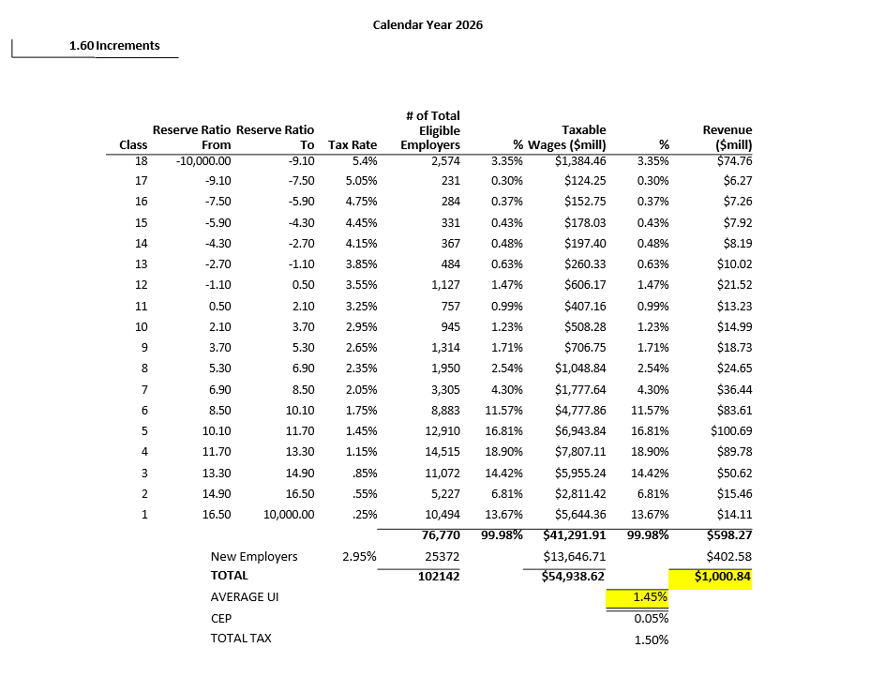

Slide 26
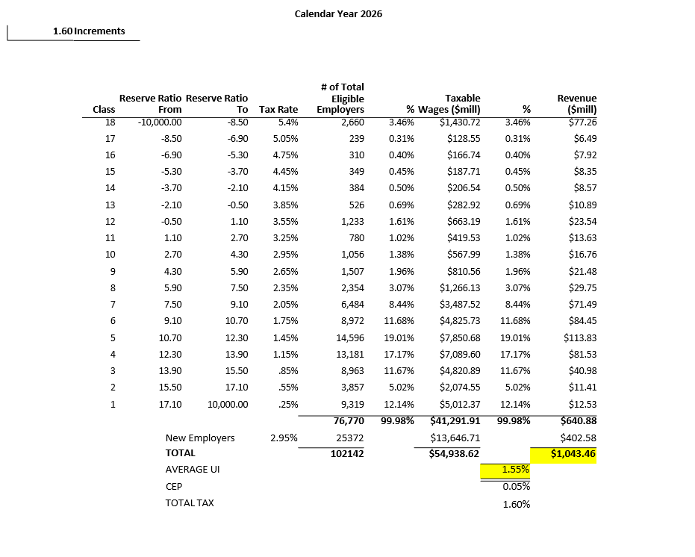

Slide 27
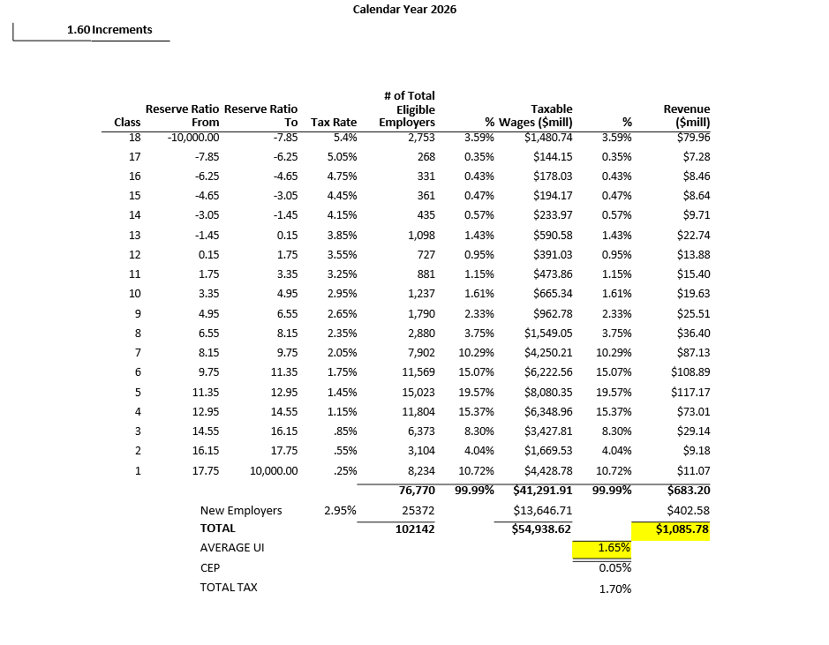

Slide 28
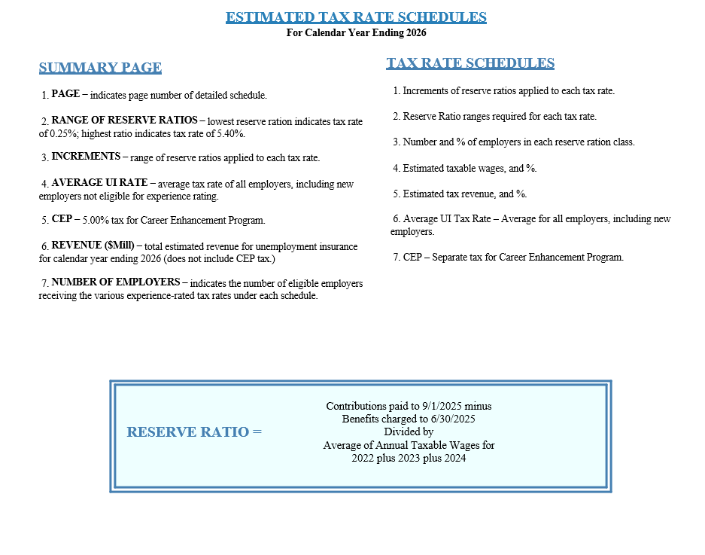

Slide 29
Employment Security Council Meeting
October 6th, 2025

Slide 30
Small Business Workshop
October 6th, 2025

Slide 34
Taking a moment…
In prior years, we’ve presented the “state solvency measure.” The COVID recession exposed significant weaknesses in this formula, and it was no longer providing valuable guidance. AB 21 of the 2025 legislative session eliminated this formula, so moving forward we’re relying on the Average High Cost Multiple (as we have
presented in the past) instead.

Slide 35
Presentation Overview
Economic Conditions and Context
Unemployment Insurance Trends
UI Trust Fund Projections and Solvency
Where are we going?

Slide 36
Current Employment Trends

Slide 37
Most Industries Added Jobs 2022-2025

Slide 38
Recent Job Trends Historically Flat

Slide 39
Annual Revisions Likely Negative

Slide 40
Wage Growth is Holding Up

Slide 41
Job Turnover is Slowing

Slide 42
Unemployment Higher than Most States

Slide 43
But Participation is Above-Average

Slide 44
Reason for Unemployment Still Positive
Current level of unemployment not driven by job loss
Great Recession
COVID Recession

Slide 45
UI Duration and Exhaustions Rising

Slide 46
Trend in New UI Claims

Slide 47
Trend in New UI Claims

Slide 48
Taxable Wage Base
Modest Employment Growth and Robust Wage Growth
* Used Annual QCEW Data
Average Employment
1,376,705 (2024) to 1,387,410(2026)
Annual Wage (Total wages/ Average Employment
$65,771(2024) to $71,709 (2026)
Average ratio of taxable wages to total wages
55.52%
Forecasted value of average employment * fore-casted value of annual wage * average ratio of taxable wages to total wages =
$54,946,690,671

Slide 49
Projected Contributions (1.65% Rate)

Slide 50
Trust Fund Impacts
Beginning Trust Fund Balance
$2,256,676,817 as of September 19, 2025
Notes:
This shows the projected balance of the trust fund given certain tax rates. The contributions values follow the same predictive model used before (change in annual wage * change in average employment * average ratio of taxwage/totalwage) for the taxable wage base. From there, we multiply it by one of the rates displayed. Benefits is calculated by last benefits value (August 1, 2025) * change in average employment * change in average weekly wage. Then use a compound growth rate. The trust fund goes up or down based on the net of these two.

Slide 51
Historic Cash Flows
 |  | Actual | Actual | Actual | Actual | Actual | Actual | Preliminary
 |  | 2019 | 2020 | 2021 | 2022 | 2023 | 2024 | 2025
UI Trust Fund Level: October - September
Beginning Fund Balance (Millions) |  | 1,416.30 | 1,864.60 | 291 | -76 | 795.5 | 1,412.9 | 1,742.9
Contributions |  | 674 | 617.9 | 595.6 | 752.7 | 828 | 848.3 | 920.3
Benefit Payments |  | 268.7 | 2,232.20 | 862.3 | 228 | 349.2 | 497.7 | 529.2
Other Items |  | 43.1 | 40.7 | -100.3 | 346.7 | 146.6 | 20.6 | 73.1
Net Change in Fund |  | 448.3 | -1,573.60 | -367 | 871.4 | 617.4 | 330.0 | 464.2
Ending Fund Balance (Millions) |  | 1,864.6 | 291 | -76 | 795.5 | 1,412.9 | 1,742.9 | 2,207.1
AHCM Solvency Level (Millions) |  | 657.3 | -987.2 | -1,861.6 | -1,297.9 | -1,110.1 | -856.5 | -475.7
AHCM Target (Millions) |  | 1,207.3 | 1,278.2 | 1,785.6 | 2,093.4 | 2,523.0 | 2,599.4 | 2,682.9
All-Time High Cost Multiple |  | 1.56 | 0.11 | -0.02 | 0.14 | 0.23 | 0.46 | 0.59
Average High Cost Multiple |  | 1.54 | 0.23 | -0.04 | 0.38 | 0.56 | 0.67 | 0.82
Average Tax Rate |  | 1.85% | 1.65% | 1.65% | 1.65% | 1.65% | 1.65% | 1.65%
CEP Assessment |  | 0.05% | 0.05% | 0.05% | 0.05% | 0.05% | 0.05% | 0.05%
Total Cost to Employers |  | 1.90% | 1.70% | 1.70% | 1.70% | 1.70% | 1.70% | 1.70%
Average Cost per Employee at Max Taxable Wage (excl FUTA & Interest) |  | $592.80 | $552.50 | $567.80 | $622.20 | $681.70 | $690.20 | $710.60
Taxable Wage Base |  | $31,200 | $32,500 | $33,400 | $36,600 | $40,100 | $40,600 | $41,800
Without COVID, we’d be at an AHCM of 1.18, or around $350 million above solvency level.

Slide 52
Projected Cash Flows
 |  | 1.45% Forecast | 1.65% Forecast | 1.0 AHCM Forecast
 |  | 2026 | 2026 | 2026
UI Trust Fund Level: October - September
Beginning Fund Balance (Millions) |  | $2,207.1 | $2,207.1 | $2,207.1
Contributions |  | 796.7 | 906.6 | 1,016.3
Benefit Payments |  | 576.0 | 576.0 | 576.0
Other Items |  | 40.2 | 41.1 | 42.0
Net Change in Fund |  | 260.9 | 371.7 | 482.3
Ending Fund Balance (Millions) |  | $2,468.0 | $2,578.8 | $2,689.4
Solvency Level (Millions) |  | -$221.4 | -$110.6 | -
All-Time High Cost Multiple |  | 0.66 | 0.69 | 0.72
Average High Cost Multiple |  | 0.92 | 0.96 | 1.0
Non-COVID AHCM |  | 1.32 | 1.38 | 1.44
Average Tax Rate |  | 1.45% | 1.65% | 1.85%
CEP Assessment |  | 0.05% | 0.05% | 0.05%
Total Cost to Employers |  | 1.50% | 1.70% | 1.90%
Average Cost per Employee at Max Taxable Wage (excl FUTA & Interest) |  | $655.50 | $742.90 | $830.30
Taxable Wage Base |  | $43,700 | $43,700 | $43,700

Slide 53

Small Business Impact Statement
Department of Employment, Training, and Rehabilitation NAC 612.550 Rates for employers
Pursuant to NRS 241.020 and 233B.0608
Description of the manner in which comments were solicited from affected small businesses, a summary of their responses, and an explanation of the manner in which other interested persons may obtain a copy of the summary.
On September 8, 2025, the Division publicly posted notice of the meeting notice and agenda for the Workshop to Address the Impact of Proposed Regulation on Small Businesses to solicit public comments pursuant to NRS 241.020 and 233B.061. Said Small Business Workshop is being held on October 6, 2025 immediately following the Employment Security Council (ESC) public meeting that begins at 1:00 PM.
Manner and Method of Analysis
This analysis was conducted by the state employee, DETR’s Chief Economist, with the most understanding of the subject of unemployment insurance, projected benefit and contributions, and ability to make a valid and educated determination as to the potential impact of said regulation amendments and repeals based on said economic analyses conducted and considerations from any/all public comments received by the Department during this rulemaking process. Analysis of expected benefit costs comes from a model of estimated employment growth and estimated average wage growth on a quarter-by-quarter basis throughout the time period to which the regulation would apply. Data about the number, size, and distribution of employers comes from the records of the Division from the required reports filed by those employers,
Estimated Economic Impact
All Nevada employers subject to Unemployment Insurance (UI) contributions and eligible for experience rating will be affected by the proposed regulations constituting approximately 76,770
employers or 75.2% of all employers registered with the Employment Security Division. The
proposed regulations represent a range of options ranging from a decrease in the average UI Contribution rate to 1.35% to an unchanged average UI Contribution rate at 1.65% from 2025 to 2026.
Beneﬁcial Impacts
Under all proposed regulation alternatives, the average burden on employers will either remain steady or could decrease and will not revert to the standard contribution rate of 2.95%. Further, these contributions are expected to exceed benefit payments and will continue to allow the state to build its Trust Fund reserves.
Adverse Impacts
The only employers who will experience a higher contribution rate are those whose UI experience causes them to receive a rate higher than the standard rate of 2.95%. Under the 1.65% average rate schedule, approximately 1,609 have a positive reserve ratio and have paid more in UI Contributions than received UI benefit charges over the life of their account while 5,246 have a negative ratio and have resulted in a net cost to the system. Under the 1.35% schedule, 1,235 of these employers have
a positive reserve ratio, while 4,602 have a negative ratio.
Indirect Impacts
This regulation complies with the federal compliance regulations governing Unemployment Insurance contribution rates. Therefore, employers maintain eligibility for a full 5.4% credit toward their federal unemployment insurance taxes. In addition, the additional solvency in the UI system will help to pay for unemployment benefits in the future. On average, evidence suggests that for each dollar in UI benefits, $2 or more in economic activity results. In addition, employers’ benefit as funds are returned to the economy through UI benefit payments, helping to mitigate the drop in consumption that takes place in a recession. Finally, the UI system helps to maintain the attachment of workers to the local workforce and facilitate a faster return to work, both through job search and training services and through mandatory work search requirements.
Consideration of Impact on Small Businesses
By using an experience-rated structure, employers’ tax rates depend primarily on their own experience with unemployment, without regard for employer size or industry type. The distribution
of small employers through the UI contribution schedule closely mirrors that of the state, generally varying by no more than 0.5%. The standard contribution rate remains fixed by statute at 2.95%. Additionally, federal laws only allow the State to assign rates of less than the standard rate to employers based on their experience with respect to unemployment, so no preferential rates may be assigned to small businesses.
Estimated Cost of Enforcement
This regulation amendment will be enforced as a regular part of ongoing UI operations and does not represent any additional burden on staff time, as the regulation is used to modify contribution rates each year. Funding for the administration of the UI program is provided to the Department by the US Department of Labor.
Anticipated Revenue Increase and Use
As this regulation adopts a lower average contribution rate than the standard rate of 2.95%, there is no anticipated revenue increase as a result of this regulation.
Duplication or More Stringent Standards than Federal, State, or Local Governments This regulation is only an annual modification to the unemployment insurance contribution schedule, therefore, the determination of the Division that this regulatory review is not anticipated to result in duplication or more stringent standards than those of federal, state, or local governments
The Reason for the Conclusions of the Agency Regarding the Impact of the Regulation on Small Businesses
The distribution of small business employers closely matches the overall distribution of all employers in the state and because Unemployment Insurance (UI) law does not allow states to assign rates of less than the standard rate, 2.95% in Nevada, except on the basis of an employer’s prior experience with respect to unemployment; the agency believes that there is no disparate impact to small businesses due to this regulation.
Certification of Concerted Effort to Determine Impact on Small Business and Accuracy of Statement
I certify that to the best of my knowledge or belief, a concerted effort was made by the Department of Employment, Training, and Rehabilitation to determine the impact of this regulation on small business, and that the information contained in this statement has been prepared properly and is accurate.
Direct Impacts
The direct impact of this regulation on any particular Nevada business depends on that business’ prior experience with respect to unemployment. Because the rates that employers pay are fixed in statute, the average rate is reviewed each year in the regulatory process by adapting a range of reserve ratios which will apply to those rates. Each employer’s reserve ratio changes each year as
well, rising or falling, depending on the net balance of UI contributions and benefit charges from and to that account.

Slide 54
STATE OF NEVADA
Department of Employment, Training, and Rehabilitation
EMPLOYMENT SECURITY DIVISION
2026
ESTIMATED TAX RATE SCHEDULES
For
Unemployment Insurance
Employment Security Council Meeting and Small Business Impact
11-Sep-2025

Slide 55
SUMMARY
Estimated Distribution of Employers Calendar Year 2026
Page # |  |  | 2 |  | 3 |  |  | 4
Range of |  |  | -9.10 |  | -8.50 |  |  | -7.85
Reserve Ratios |  |  | 16.50 |  | 17.10 |  |  | 17.75
Increments |  |  | 1.60 |  | 1.60 |  |  | 1.60
Average UI Rate |  |  | 1.45 |  | 1.55 |  |  | 1.65
CEP |  |  | 0.05 |  | 0.05 |  |  | 0.05
Total |  |  | 1.50 |  | 1.60 |  |  | 1.70
REVENUE (mil) |  |  | $598.27 |  | $640.88 |  |  | $683.20
 | 5.40% | 2,574 | ELIGIBLE EMPLOYERS | 2,660 |  |  | 2,753
 | 5.05% | 231 |  | 239 |  |  | 268
 | 4.75% | 284 |  | 310 |  |  | 331
 | 4.45% | 331 |  | 349 |  |  | 361
 | 4.15% | 367 |  | 384 |  |  | 435
 | 3.85% | 484 |  | 526 |  |  | 1,098
 | 3.55% | 1,127 |  | 1,233 |  |  | 727
 | 3.25% | 757 |  | 780 |  |  | 881
 | 2.95% | 945 |  | 1,056 |  |  | 1,237
 | 2.65% | 1,314 |  | 1,507 |  |  | 1,790
 | 2.35% | 1,950 |  | 2,354 |  |  | 2,880
 | 2.05% | 3,305 |  | 6,484 |  |  | 7,902
 | 1.75% | 8,883 |  | 8,972 |  |  | 11,569
 | 1.45% | 12,910 |  | 14,596 |  |  | 15,023
 | 1.15% | 14,515 |  | 13,181 |  |  | 11,804
 | 0.85% | 11,072 |  | 8,963 |  |  | 6,373
 | 0.55% | 5,227 |  | 3,857 |  |  | 3,104
 | 0.25% | 10,494 |  | 9,319 |  |  | 8,234
 |  | 76,770 |  | 76,770 |  |  | 76,770

Slide 61
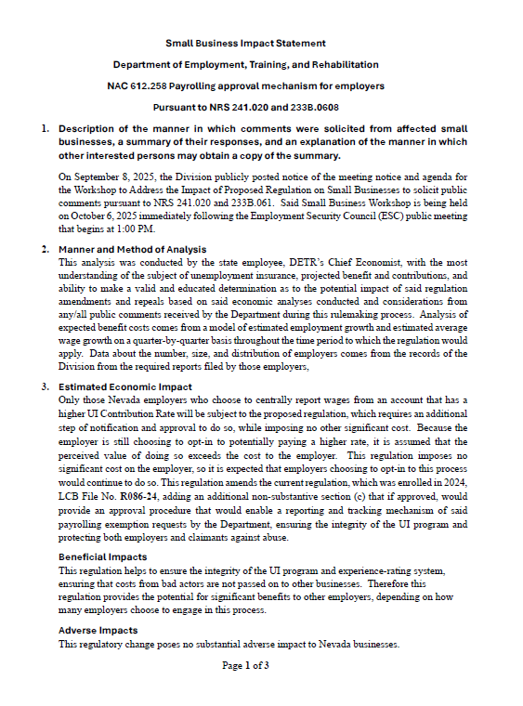
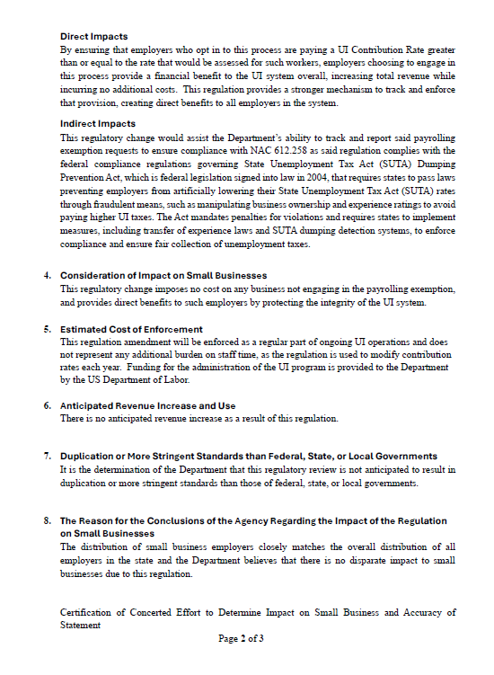

Slide 62


Slide 63
Small Business Workshop
October 6th, 2025

